Slide 1
Garbage Collection in C#
Viktor Dakov

Slide 2
Table of Contents
Stack and Heap
Memory Management
Managed management
Unmanaged management
Garbage Collector in .NET
Generations
Large object heap
Memory leaks

Slide 3
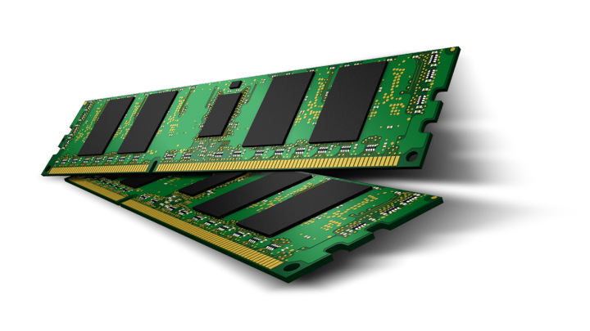
Memory 101
Stack, Heap, Shallow and Deep Copy

Slide 4
Value and Reference Types
Value type
Derived from System.ValueType - int , bool , char , enum and any struct
Can be allocated on the heap or on the stack, depending on where they were declared
If the value type was declared as a variable inside a method then it's stored on the stack
Reference type
Derived from System.Object - Class, Interface, delegate, object, string
It is used by a reference which hold a reference to the object but not the object itself
Pointer
In computer science, a pointer is a programming language object that stores the memory address of another value located in computer memory

Slide 5
What is a Stack?
Stored in computer RAM
Much faster to allocate in comparison to variables on the heap
Stores local data, return addresses, used for parameter passing
Can have a stack overflow when too much of the stack is used
Data created on the stack can be used without pointers
Usually has a maximum size already determined when your program start

Slide 6
What is a Heap?
Stored in computer RAM
Slower to allocate in comparison to variables on the stack
Used on demand to allocate a block of data for use by the program
Can have allocation failures if too big of a buffer is requested to be allocated
Usually memory leaks occurs there

Slide 7
How They are Stored?
Stack
Heap
Start
AddFive()

Slide 8
How They are Stored?
Stack
Heap
pValue | int
Start
AddFive()

Slide 9
How They are Stored?
Stack
Heap
result | POINTER
pValue | int
Start
AddFive()

Slide 10
How They are Stored?
Stack
Heap
result | POINTER
MyInt
pValue | int
MyValue | int
Start
AddFive()

Slide 11
How They are Stored?
Stack
Heap
Delete this
result | POINTER
MyInt
pValue | int
MyValue | int
Start
AddFive()

Slide 12
How They are Stored?
Stack
Heap
MyInt
MyValue | int

Slide 13

Value Types as Parameters
Big Values

Slide 14
How Big Value Types are Stored?
Stack
pValue | MyStruct
MyMethod()
x | MyStruct
Run()

Slide 15
Big value types using ref
Stack
pValue | MyStruct
MyMethod()
x | MyStruct
Run()

Slide 16

Memory Management

Slide 17
Memory is a Finite Resource
No computer has an infinite amount of memory
Programs must obtain, use and release memory as they execute
Memory management in the manner in which we obtain and release memory
Tasks of the memory management system
Allocation of free space
Reclamation of unused space and Tracking

Slide 18
Two Fundamentals Means of Management
Manual
Human error
Space reclaimed twice
Reclaimed space accessed
Space never reclaimed
Space overwritten
Neither Is Perfect
Automatic
Space managed ineffectively
Space not reclaimed immediately
Overhead (time and space) incurred
Neither Is Perfect

Slide 19

GC Algorithms

Slide 20

GC Algorithms
Reference counting
Cycles
Space overhead
Not widely used
Mark-sweep
Mark-compact
Mark-sweep-compact
Generational collectors

Slide 21

CLR Garbage Collector
Let the system manage itself

Slide 22
.NET CLR GC Principles
"GCs should occur often enough to avoid the managed heap containing a significant amount of garbage and therefore use memory unnecessarily."
"GCs should happen as infrequently as possible to avoid using otherwise useful CPU time, even though frequent GCs would result in lower memory usage."
"If GC reclaims a small amount of memory, then the GC was wasted."

Slide 23
Conditions for a garbage collection
It occurs when one of the following conditions is true:
The system has low physical memory
The memory that is used by allocated objects on the managed heap surpasses an acceptable threshold.
The GC.Collect() method is called
In almost all cases, you do not have to call this method

Slide 24
How is memory allocated in .NET?
The size of the new object is calculated
Checking for free memory
If there is free memory, it is allocated and the constructor is called to initialize it
If there is no memory, the garbage collector is started
If there is still no memory after its operation, an OutOfMemoryException is triggered

Slide 25
Managed vs Unmanaged Code
Managed
Unmanaged
It is executed by the CLR
It provides security
It provides runtime services like Garbage Collection, exception handling, etc.
any code which does not run under the .NET CLR
It does not provide any security
It does not provide services like Garbage Collection

Slide 26



GC Generations
0 1 2

Slide 27
GC Generations – 0, 1 and 2
Generation 0
It contains short-lived objects like temporary variables
The garbage collection occurs most frequently in this generation
Generation 1
It is also contains short-lived objects and works as a buffer between short lived objects and long lived objects
Generation 2
It contains long-lived objects like static data

Slide 28
GC Generations
Initially objects are created in Generation 0
The object is promoted to Generation 1 if they are alive when collection occurs on Generation 0
The same objects are promoted in Generation 2 if they are alive when the collection occurs on Generation 1
Gen 2
Gen 1
Gen 0
Other Memory
Next object pointer

Slide 29

Large object heap
Objects greater than 85000 bytes go directly to LOH
LOH objects go directly to generation 2
Compacting large objects is expensive
No compaction is done on LOH

Slide 30

Memory Leaks

Slide 31
Forms of Memory Leaks
Unmanaged leaks (code that allocates unmanaged code)
Resource leaks (code that allocates and uses unmanaged resources, like files, sockets)
Extended lifetime of objects
Incorrect understanding of how GC and .NET memory management works
Bugs in the .NET runtime

Slide 32
Thank you!
Контакти:
LinkedIn: https://www.linkedin.com/in/viktor-dakov-30961396/
Github: https://github.com/wikss
Facebook: Viktor Dakov
Questions?

